Slide 1









Mobile Application Development and Big Data
Eduvos (Pty) Ltd (formerly Pearson Institute of Higher Education) is registered with the Department of Higher Education and Training as a private higher education institution under the Higher Education Act, 101, of 1997. Registration Certificate number: 2001/HE07/008

Slide 2
Press Record… ☺

Slide 3

Get Ready
Room Temperature Check
Resources: MyLMs Access
Timetable : Check Timetable regularly
Tools : Android Programming Language

Slide 4
Get Ready
Ways of Working
Communications:
  Email
  Teams (Preferred)
Content Delivery – Online Sessions

Slide 5
Get Ready
Assessments
Project
Online test Block 1
Summative assessment Block 2

Slide 6
Get Ready
Module Objectives
Develop Basic Web Pages.
Apply CSS for Styling and Layout.
Develop Interactive Web Pages with JavaScript.
Evaluate and apply Node.js and JavaScript Modules.
Create Asynchronous Programming and Implement Control Flow.

Slide 7
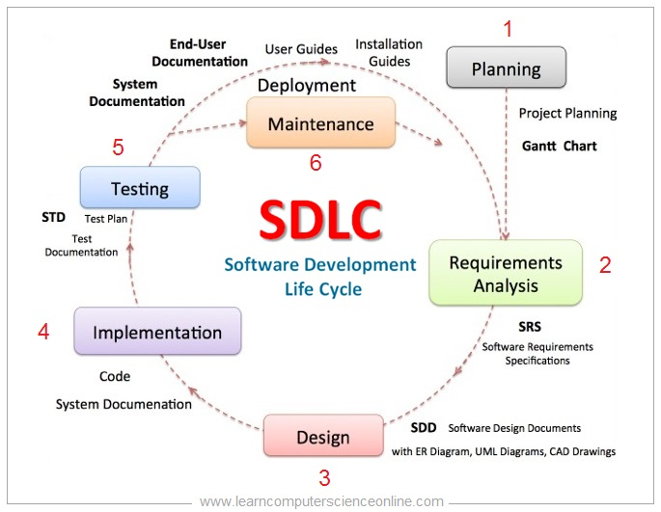
Get Ready : Lesson 1
Software Development

Slide 8
Get Ready : Lesson 1
Mobile Application Development and Big Data
What do you understand by Mobile Application Development and Big Data?

Slide 9
Questions for Discussion

Slide 10
Week 1 : Lesson 1
Mobile systems
Mobile systems refer to the technology and infrastructure that enable communication and computing on portable devices such as smartphones, tablets, smartwatches, and other handheld devices.
These systems have revolutionized the way we communicate, access information, and perform various tasks on the go.
Mobile systems refer to computing platforms, applications, and technologies designed for use on mobile devices, such as smartphones, tablets, and wearables.

Slide 11
Week 1 : Lesson 1
History of Mobile Systems
The history of mobile systems dates back to the early 20th century when wireless communication technologies started to emerge.
The first mobile communication systems were primarily used for voice calls and were limited in terms of coverage and capacity.
Over the years, advancements in technology led to the development of more sophisticated mobile systems capable of supporting data transmission, multimedia services, and internet connectivity.

Slide 12
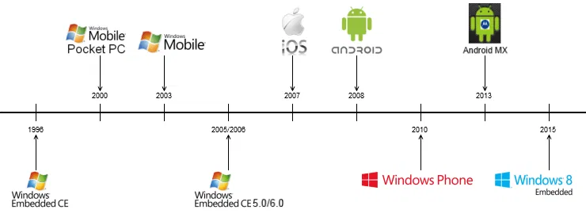
Week 1 : Lesson 1
History of Mobile Systems

Slide 13
Week 1 : Lesson 1
How Mobile Systems Work
Mobile systems rely on a combination of hardware and software components to enable communication and computing.
The hardware components include mobile devices (e.g., smartphones, tablets) equipped with processors, memory, storage, and wireless communication modules.
The software components consist of operating systems specifically designed for mobile devices, such as Android and iOS, which provide the necessary interface and functionality for users to interact with their devices.

Slide 14
Week 1 : Lesson 1
How Mobile Systems Work
Mobile systems utilize various wireless communication technologies, such as cellular networks, Wi-Fi, Bluetooth, and satellite systems, to establish connections and transmit data.
These technologies enable users to make voice calls, send text messages, access the internet, use mobile applications, and perform a wide range of tasks.

Slide 15
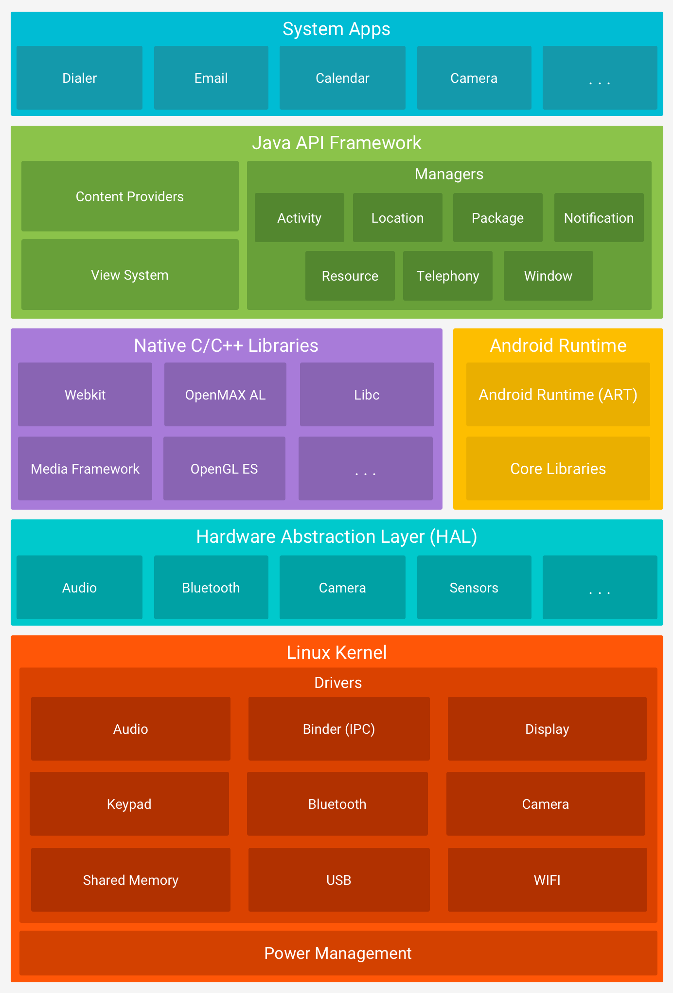
Week 1 : Lesson 1
How Mobile Systems Work

Slide 16
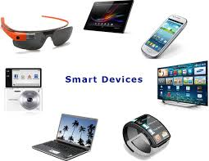
Week 1 : Lesson 1
Mobile Devices
Smartphones
Tablets
Smartwatches
Other Mobile Devices - e-readers, portable gaming consoles, and specialized devices used in industries like healthcare and logistics.

Slide 17
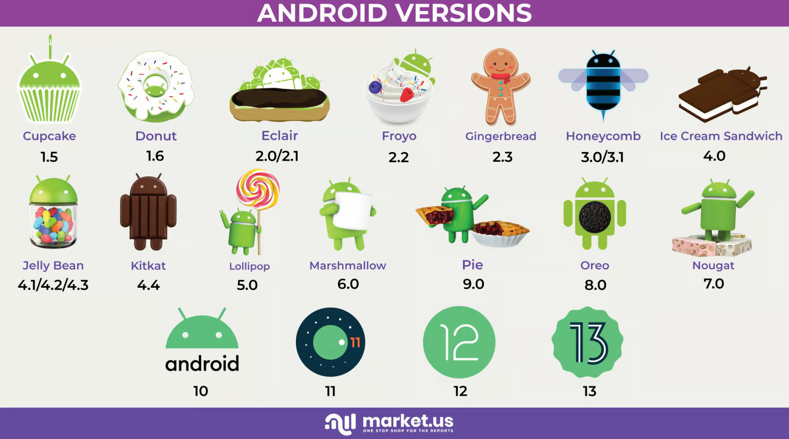
Week 1 : Lesson 1
Operating Systems
iOS: Developed by Apple for iPhones and iPads, iOS provides a secure and controlled environment. It is known for its user-friendly interface and seamless integration with Apple's ecosystem.
Android: Developed by Google, Android is an open-source operating system used by a variety of manufacturers. It offers customization options and a wide range of applications through the Google Play Store.

Slide 18
Week 1 : Lesson 1
Application Ecosystem
App Stores: Mobile systems rely on app stores (e.g., Apple App Store, Google Play Store) where users can discover, download, and update applications.
App Development: Developers use various programming languages (Swift, Kotlin, Java) to create mobile applications catering to diverse needs, from productivity and entertainment to health and education.

Slide 19
Week 1 : Lesson 1
Connectivity and Networks
Wireless Technologies: Mobile systems leverage wireless technologies like 4G and 5G for high-speed internet access, enabling seamless communication and data transfer.
Bluetooth and NFC: Short-range communication technologies like Bluetooth and Near Field Communication (NFC) facilitate device pairing and data exchange.

Slide 20
Week 1 : Lesson 1
Security and Privacy
Biometric Authentication: Mobile systems incorporate biometric features such as fingerprint sensors and facial recognition for secure user authentication.
App Permissions: Users can control the access apps have to device features (camera, location, contacts) through permission settings.
Developer Security Consideration:
  Data encryption
  App security testing
  Secure data storage

Slide 21
Week 1 : Lesson 1
Mobile Hardware
Processor and Memory - Mobile devices are equipped with powerful processors and varying amounts of RAM to handle multitasking and demanding applications.
Sensors - Mobile systems include sensors like accelerometers, gyroscopes, and GPS, enabling advanced functionalities such as motion sensing and location tracking.

Slide 22
Week 1 : Lesson 1
Mobile Cloud Computing
Cloud Integration - Mobile systems often integrate with cloud services, allowing users to store data, access applications, and synchronize content across multiple devices.
Cloud Integration - Mobile systems often integrate with cloud services, allowing users to store data, access applications, and synchronize content across multiple devices.

Slide 23
Week 1 : Lesson 1
Mobile User Interface (UI) Design
Responsive Design - Mobile UI design focuses on responsiveness to accommodate different screen sizes and orientations.
Gesture Controls - Intuitive gestures (swiping, tapping, pinching) are incorporated for easy navigation on touch screens.

Slide 24
Week 1 : Lesson 1
General Characteristics of Mobile Systems
Portability
Wireless Connectivity
Touchscreen Interfaces
Location Awareness
App Ecosystem
Multimedia Capabilities
Battery Life

Slide 25
Week 1 : Lesson 1
Mobile Interface and Applications
Mobile interface design plays a crucial role in the success of mobile applications.
It focuses on creating user-friendly and visually appealing interfaces that enhance the user experience.

Slide 26
Week 1 : Lesson 1
Mobile Interface and Applications Key Points
Importance of Mobile App UI Design :
  Delivering outstanding user experiences and meeting business needs.
  It helps introduce and market mobile applications effectively .
  Good UI design attracts and retains loyal customers, as it grabs their attention and makes the app easy to use .
  It helps build a brand by making the content engaging, navigation less complicated, and increasing user satisfaction .

Slide 27
Week 1 : Lesson 1
Mobile Interface and Applications Key Points
Types of User Interfaces for Mobile Apps:
  Mobile apps consist of various types of user interfaces, including splash screens, login screens, home screens, navigation menus, forms, and more.
  Each type of screen has its own design features and requirements, depending on the purpose and functionality of the app.

Slide 28
Week 1 : Lesson 1
Mobile Interface and Applications Key Points
Usability and User Interface Design :
  Usability is a critical aspect of user interface design.
  Designing with usability in mind saves time and cost in the long run, as it reduces the need for frequent app revamps .

Slide 29
Week 1 : Lesson 1
Mobile Interface and Applications Key Points
Mobile App Design Principles:
  Mobile app design follows key principles to create great, functional interfaces .
  These principles include considering the app's requirements, conceiving and building design requirements, and implementing the designs effectively .

Slide 30
Week 1 : Lesson 1
Mobile Interface and Applications Key Points
Mobile App Design Principles:
  Mobile app design follows key principles to create great, functional interfaces .
  These principles include considering the app's requirements, conceiving and building design requirements, and implementing the designs effectively .

Slide 31
Week 1 : Lesson 1
Optimisation in Mobile Systems
Optimization in mobile systems is crucial for enhancing the performance, efficiency, and user experience of applications and devices.
Mobile devices, such as smartphones and tablets, have resource constraints, including limited processing power, memory, and battery life.
optimizing mobile systems involves making efficient use of these resources to deliver smooth and responsive experiences.

Slide 32
Week 1 : Lesson 1
Optimisation in Mobile Systems Key areas
Code Optimization :
  Minification and Obfuscation
  Code Splitting - Divide the code into smaller modules to load only the necessary components when required, reducing initial loading times.
Memory Management:
  Garbage Collection
  Memory Profiling

Slide 33
Week 1 : Lesson 1
Optimisation in Mobile Systems Key areas
Network Optimization:
  Data Compression
  Caching
Battery Efficiency
  Background Processes
  Location Services

Slide 34
Week 1 : Lesson 1
Optimisation in Mobile Systems Key areas
User Interface (UI) Optimization:
  Image and Resource Optimization
  Lazy Loading
App Performance Monitoring:
  Analytics and Monitoring Tools
  A/B Testing

Slide 35
Week 1 : Lesson 1
Optimisation in Mobile Systems Key areas
User Interface (UI) Optimization:
  Image and Resource Optimization
  Lazy Loading
App Performance Monitoring:
  Analytics and Monitoring Tools
  A/B Testing
Database Optimization:
  Indexed Queries
  Local Databases: Use local databases to store frequently accessed data, reducing the need for repeated server queries.

Slide 36
Week 1 : Lesson 1
Mobile Cloud Computing
Mobile Cloud Computing is a technology that combines the capabilities of mobile devices with the resources and services offered by cloud computing.
This integration allows mobile users to access and utilize a wide range of applications, data storage, processing power, and services hosted on cloud servers.

Slide 37
Week 1 : Lesson 1
Mobile Cloud Computing Key Components
Mobile Devices - Smartphones, tablets, wearables, and other portable devices act as the client interface for accessing cloud services.
Cloud Infrastructure - Servers, storage, and networks in data centers provide the necessary resources for hosting applications and storing data.
Mobile Networks - The connectivity infrastructure (3G, 4G, 5G) enables mobile devices to communicate with cloud servers.
Cloud Services - A variety of services such as storage, computing power, databases, and software applications are hosted on the cloud.

Slide 38
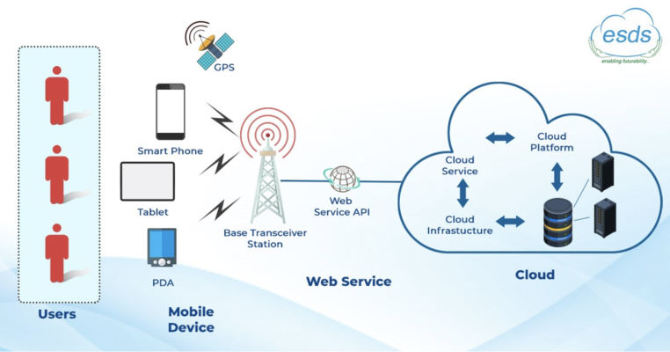
Week 1 : Lesson 1
Mobile Cloud Computing Key Components

Slide 39
Week 1 : Lesson 1
Mobile Cloud Computing Characteristics
Ubiquitous Access: Users can access cloud services anytime and anywhere, provided they have an internet connection.
Scalability: Cloud resources can scale dynamically based on demand, accommodating varying workloads and user requirements.
Resource Pooling: Cloud providers pool computing resources to serve multiple users, optimizing resource utilization.
Self-Service: Users can provision and manage cloud resources independently without requiring direct interaction with service providers.

Slide 40
Week 1 : Lesson 1
Mobile Cloud Computing Characteristics
Enhanced Storage: Mobile users can store and access data beyond the device's physical storage limits, utilizing cloud storage solutions.
Computational Offloading: Intensive computational tasks can be offloaded to cloud servers, reducing the burden on the mobile device's hardware.
Collaboration: Cloud-based applications facilitate collaboration, allowing users to share and edit documents in real-time.
Cost Efficiency: Mobile users can benefit from cost-effective cloud services without the need for extensive local hardware

Slide 41
Week 1 : Lesson 1
Mobile Cloud Computing use cases
Nice Read : https://aws.amazon.com/what-is/mobile-cloud-computing/

Slide 42
Week 1 : Lesson 1
Mobile Cloud Computing use cases
Mobile devices play a crucial role in the realm of big data, contributing to both the generation and consumption of vast amounts of data.
Big data plays a significant role in the mobile market, providing valuable insights into customer behaviour and enabling effective mobile marketing strategies.

Slide 43
Week 1 : Lesson 1
Importance of Big Data in Mobile Systems
Customer Insights
Optimizing Operations
Precision Marketing
Healthcare Applications
Data Management
Network and Device Optimization

Slide 44
Week 1 : Lesson 1
Challenges and Considerations
Resource Constraints - Mobile devices have limited resources, and processing big data on these devices can be challenging.
Security and Privacy - The storage and processing of big data in mobile and cloud computing environments require careful consideration of security and privacy measures .
Data Lifecycle - Mobile big data has a comprehensive lifecycle, including data source and collection, transmission, computing platforms, and data-driven applications

Slide 45
Week 1 : Lesson 1
Security in Mobile Systems
Mobile systems, including smartphones, tablets, and laptops, require robust security measures to protect against threats associated with wireless computing.
Importance of Mobile Security:
  Protection of Sensitive Information - Mobile security ensures the confidentiality and integrity of sensitive data stored on mobile devices.
  Prevention of Malware and Cyber Attacks - Mobile security measures aim to detect and prevent the installation of harmful apps, block phishing attacks.
  Network Security - Mobile security also encompasses network-level protection, as cybercriminals may exploit network connectivity to steal sensitive data or transmit malicious content.

Slide 46
Week 1 : Lesson 1
Security in Mobile Systems
Importance of Mobile Security:
  Operating System Updates - Keeping mobile operating systems up to date is crucial for mobile security.

Slide 47

Week 1 : Lesson 1
Security in Mobile Systems

Slide 48
Questions for Discussion

